Slide 1


Oracle database
Lecture 53

Slide 2

Today’s Agenda
PL-SQL Object Oriented Programming
What Are Object Types ?
Creating And Initializing Object Types
Adding Constrcutor
Example

Slide 3
Object Oriented PL-SQL
PL/SQL is a procedural language - mostly.
But it can also be used to implement object-oriented features in Oracle Database.
In other object-oriented languages like Java, everything is defined in classes, but in Oracle Database, we have object types.

Slide 4
What Are Object Types ?
An object type allows us to create composite types.
Using objects allow us to implement real world objects which have attributes and methods.
Attributes are properties of an object and are used for storing data ; and methods are used for behavior i.e. operations on data.

Slide 5
Creating Object Types
In Oracle, an object type is created with the CREATE OR REPLACE TYPE clause and is stored in the database schema.
Remember , object types cannot be created within a PL/SQL block or stored subprogram.
Once an object type has been created and stored in the database schema, a PL/SQL block or subprogram may use that object type.

Slide 6
Creating Object Types
CREATE [OR REPLACE] TYPE type_name AS OBJECT (attribute_name1 attribute_type, attribute_name2 attribute_type, ... method1 specification, method2 specification, ... );
CREATE [OR REPLACE] TYPE BODY type_name AS method1 body; method2 body; ... methodN body; END;

Slide 7
Points To Remember
The creation of an object type includes two parts: the object type specification and the object type body.
The object type specification contains declarations of attributes as well as any methods that may be used with that object.

Slide 8
Points To Remember
The attribute_type may be a built-in PL/SQL type such as NUMBER or VARCHAR2, or it may be a complex user-defined type such as a collection.
The method specification consists of the method type, its name, and any input and output parameters the method needs.

Slide 9
Points To Remember
The object type specification is also called a public interface, and the methods defined in it are called public methods.
These methods are optional when creating object types.
However, if an object type has a method specification, it requires an object type body.

Slide 10
Points To Remember
The object type body is optional when creating an object type.
It contains the bodies (executable statements) of the methods defined in the object type specification.
In addition, the object type body may contain methods that have not been defined in the object type specification.
These methods are private—that is, they are not visible to the outside world(such as a PL/SQL block, subprogram, or Java application).

Slide 11
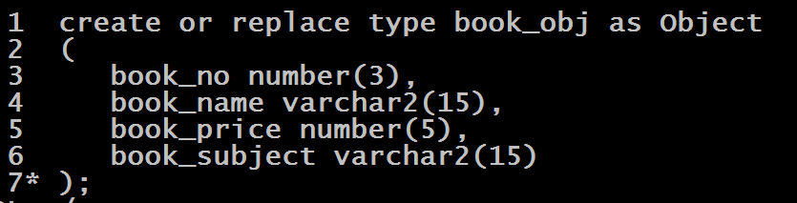
Example

Slide 12
Using Object Types
Defining an object type provides a blueprint for the object.
To use this object, we need to do 2 things:
Create instance of this object
Initialize this instance

Slide 13
How To Initialize An Object ?
Variables which are declared as objects begin their life atomically as null
Attempting to assign values to the attributes of an atomically null object will return an ACCESS_INTO_NULL exception.
Instead, we must initialize the object, in one of these ways:
Use the default constructor method
Use user-defined constructor
Assign to it the value of an existing object

Slide 14
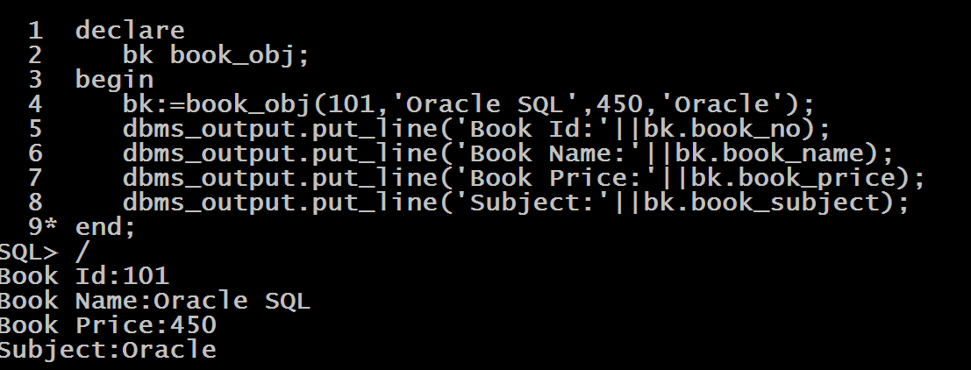
Using Object Types

Slide 15
More On Constructor
A constructor method is a default method that is implicitly created by the Oracle whenever a new object type is created.
Following are its important features:
This method has the same name as its object type.
Its input parameters have the same names and data types as the object type attributes and are listed in the same order as the object type attributes.
A constructor method returns a new instance of the object type.
In other words, it initializes the new object instance and assigns values to the object attributes.

Slide 16
Creating Our Own Constructor
PL/SQL also provides us with the ability to create our own constructors called user defined constructors
User-defined constructors offer flexibility that the default constructors lack.

Slide 17
Creating Our Own Constructor
For example, we might want to define a constructor on the book_obj that initializes only some of the attributes of the newly created object instance.
In this case, any attributes for which we do not specify values will be initialized to NULL by the system

Slide 18
Creating Our Own Constructor
Syntax:
Constructor function <name_of_object_type>(<arg_list>)
return self as result
Example:
Constructor function book_obj( book_name in
varchar2,book_price in number ) return self as result

Slide 19
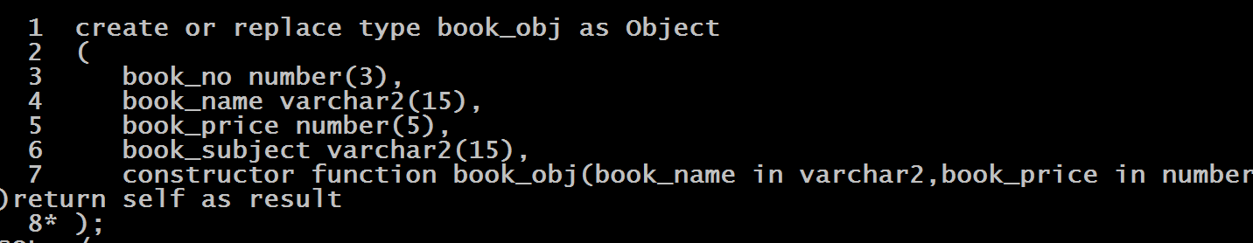
Example

Slide 20
What Is Self ?
"SELF" is a keyword that indicates we are working with attributes and methods of the instance that is being "constructed" by the function.
It is compulsory for a constructor to be a function and return the instance which is indicated by mentioning return self as result

Slide 21
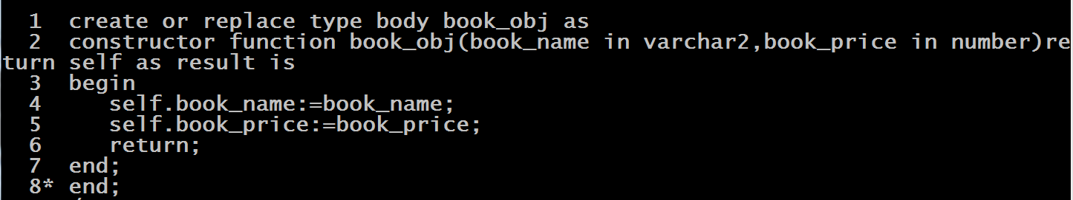
Writing The Body

Slide 22
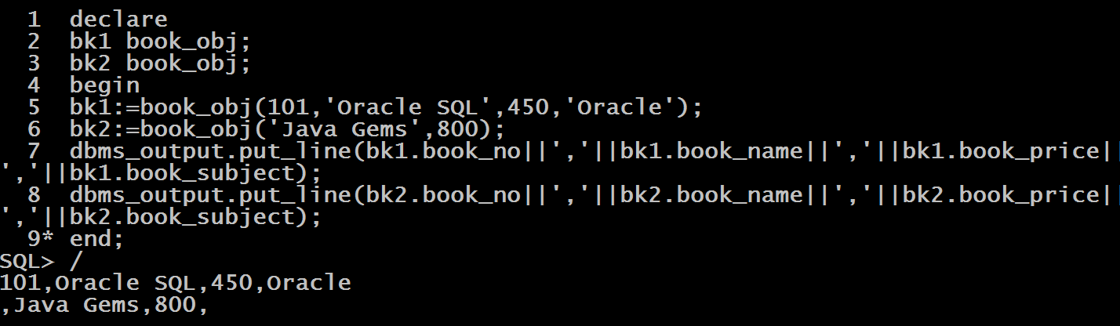
Calling

Slide 23
Adding Member Methods
A member method is a procedure or function designated with the keyword MEMBER.
Member methods are used for manipulating the attributes of the object
Calling programs may invoke such a method only on objects that have been instantiated.

Slide 24
Creating Our Own Methods
Syntax:
Member function <name_of_function>(<arg_list>)
return <data_type>

Slide 25
Exercise
Create an object type called book_obj containing members as book_no , book_name , book_price and book_subject .
Also provide two member methods in your type called get_category and display.
The method get_category should return “Low” or “High” depending on whether the book price is less than 501 or above it.
Then define the body of the type.
Finally create 2 objects of the book_obj called book1 and book2

Slide 26
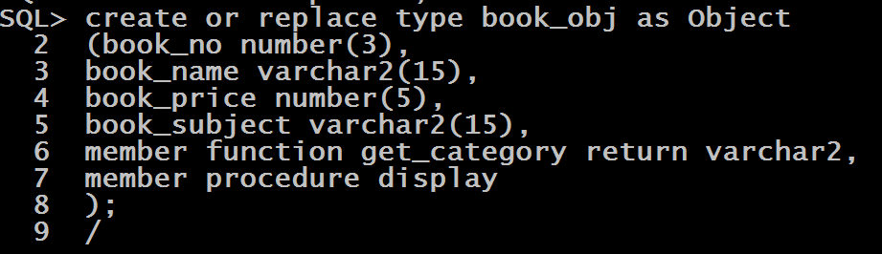
Example

Slide 27
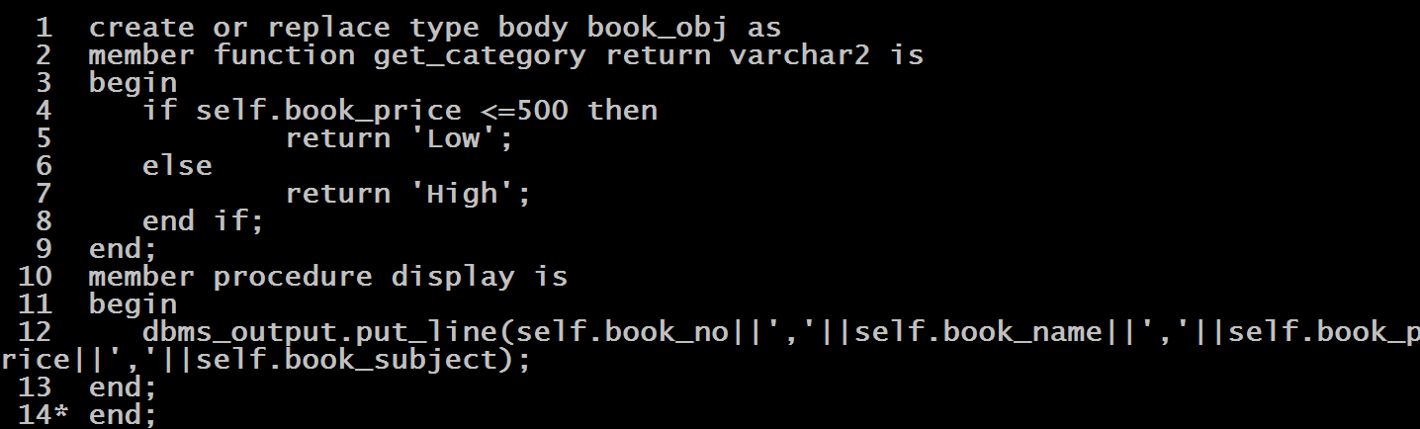
Example

Slide 28
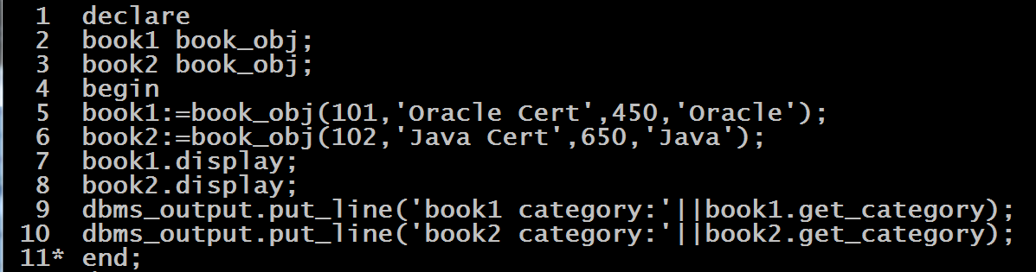
Example

Slide 29
Exercise
Create an object type called itax for calculating income tax of a person.
It should have following members: pname, bsal,da,savings,taxp
Also provide following member methods in your type :
Gross_sal(): This method should calculate and return the gross salary of the person , which is his yearly salary calculated by adding da in bsal
Taxable_amt(): This method should return the taxable amount of the person , which is gross salary –yearly savings
Tax(): This method should calculate and return the income tax the person has to pay

